Slide 1
Player RSVP by: July 11th, 2018
Sponsor Commitments by – July 1st, 2018
Sponsorship Opportunities
Monday, September 30th, 2019
Time tbc
TPC Harding Park
San Francisco

Slide 2
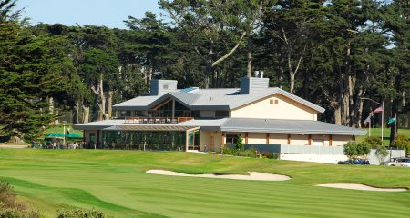
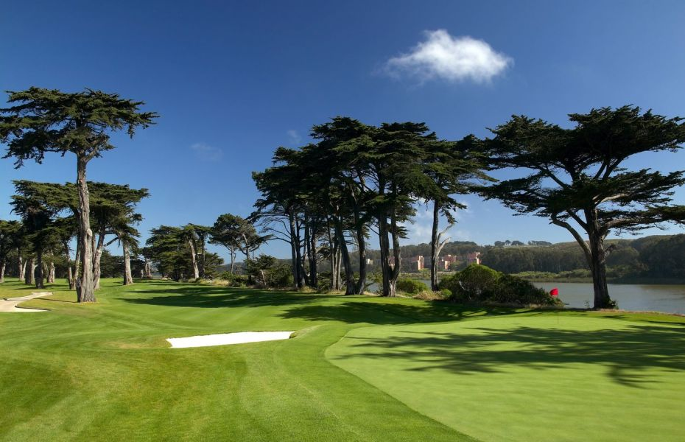
Rugby World Cup Sevens International Golf Scramble 2018
Hosted by the Australian American Chamber of Commerce and The British American Business Council
We are seeking your support as a sponsor for the 9th Annual International Summer Golf Scramble to benefit the Australian American Chamber of Commerce and the British American Business Council. This event will be held on Monday, September 30st, 2019 at the prestigious TPC Harling Park, San Francisco.
The Tournament offers a unique opportunity to target your company to an excellent field of international golfers and to the mailing lists of the international chambers of commerce.
The tournament will have 100+ golfers competing in a scramble format. The teams will be made up of both corporate and individual groups.
The player foursomes that are included with the Presenting and Eagle level sponsorships offer an excellent opportunity to entertain key clients or reward deserving employees.
Player RSVP by: September 23rd, 2019
Sponsor Commitments by – September 2nd, 2019
Player RSVP by: September 23rd, 2019
Sponsor Commitments by – September 2nd, 2019

Slide 3
Organization Reach
Rugby World Cup Sevens International Golf Scramble 2018
Hosted by the Australian American Chamber of Commerce and The British American Business Council
Participants will enjoy a fun day of golf with on course games and competitions and the chance to win great prizes. The post tournament Awards Dinner will feature some exciting Live and Silent Auction items. Beyond. Tickets include: golf, golf cart, lunch, dinner and beverages. Past participants of the AACC/BABC Annual Golf Tournament include players from the following Bay Area companies:
Able Engineering Services
Advantage Fitness Products
Artiman
Blue Earth Ink
British Airways
CCW Business Solutions
City Park
Cognizant Technology Solutions
Comm Vault
Cypress Security
Eleven, Inc.
EON Venture
Ericsson
Fairmont San Francisco
Field Vineyards
FNB Norcal
Frank Rimmerman & Co
Gleeds USA
Green Worldwide Shipping
HSBC Bank
InterContinental Hotel
InterVision Systems Technologies
iPresent
ISearch Media,
Legend Merchant Group
Levis
LoopUp
Los Gatos Luxury Cars
Marriott Hotel, San Francisco
Martensen & Wright,
mppAPPs
Onyx
Oracle
Peak Travel
Pet Express
Perkins Cole
PriceWaterhouseCoopers
Redbull
RHS Financial
SAAB
SAS
SearchForecast
Sensear
Sony Mobile
Specialtys Bakery
Spott, Lucey & Wall
SRA Captial
STLGip Law Firm
SuperShuttle
Swith Automation
Telstra Global
Truphone
Unispace
Victorian Government
Vinnova
Player RSVP by: September 23rd, 2019
Sponsor Commitments by – September 2nd, 2019

Slide 4
Rugby World Cup Sevens International Golf Scramble 2018
Hosted by the Australian American Chamber of Commerce and The British American Business Council
Below you can see the combined outreach from both the Australian American Chamber of Commerce San Francisco (AACC) & the British American Business Council (BABC).
 | AACC | BABC | Combined
Member Accounts | 175 | 214 | 505
Member Reps | 705 | 695 | 1,400
Database (mailing list) | 2,600 | 4,019 | 6,619
Twitter | 459 + Australian Embassy account | 1,377 | 1.836+
Facebook | 1,777 Also Australian in SF page | 828 | 2,605+
LinkedIn Page | 227 Dawn Lillington 500+ | 1896 Jo Healey 500+ | 3,123+
Flagship Event Attendees | 500+ Australia Day Gala | 1000+ Christmas Lunch | 1500+
Player RSVP by: September 23rd, 2019
Sponsor Commitments by – September 2nd, 2019

Slide 5
Compare Sponsor Benefits
Pre-Event Promotion
Presenting $15,000 (1 available) | Albatross $7,500 (1 available) | Eagle $2,500 (4 available) | Birdie $1,500 (6 available) | Tee/Hole $1000/$500 (8 available)
Company Logo in Event Title as Presenting Sponsor | ✔
Company logo on event branding image | ✔ | ✔ | ✔
Company logo/link as Sponsor on Event webpage | ✔ Top Position | ✔ Below Presenting | ✔ Below Albatross | ✔ Below Eagle | ✔ Below Birdie
Company logo/link on all event related emails | ✔ Top Position | ✔ Below Presenting | ✔ Below Albatross | ✔ Below Eagle | ✔ Below Birdie
Shout-Outs on Social Media | ✔ 6 | ✔ 4 | ✔ 3 | ✔ 2 | ✔ 1
Player RSVP by: September 23rd, 2019
Sponsor Commitments by – September 2nd, 2019

Slide 6
Compare Sponsor Benefits
On-Course Activation
Presenting $15,000 (1 available) | Albatross $7,500 (1 available) | Eagle $2,500 (4 available) | Birdie $1,500 (6 available) | Tee/Hole $1000/$500 (8 available)
Player Foursomes/tickets | ✔ Three Foursomes | ✔ Two Foursomes | ✔ One Foursome | ✔ Two Player Tickets
Logo on Player Gift Bag | ✔ | ✔
Opportunity to provide branded merchandise/Gift for Players | ✔ | ✔ | ✔
Sole Sponsor on all Hole Flags | ✔
Company Logo on Hole, Tee and Drinks Cart Signs | ✔ All Signs | ✔ 2 Tee Signs | ✔ 1 Tee Sign
Tent / Table | ✔ | ✔ | ✔
Advertisement in Tournament Program | ✔ Double Page | ✔ Full Page | ✔ Half Page | ✔ Quarter Page | ✔ Logo on Back Page
Player RSVP by: September 23rd, 2019
Sponsor Commitments by – September 2nd, 2019

Slide 7
Compare Sponsor Benefits
Clubhouse Activation
Presenting $15,000 (1 available) | Albatross $7,500 (1 available) | Eagle $2,500 (4 available) | Birdie $1,500 (6 available) | Tee/Hole $1000/$500 (8 available)
Opportunity to address the audience | ✔
Tickets to Awards Dinner | ✔ 12 | ✔ 8 | ✔ 4 | ✔ 2 | ✔ 2
Logo displayed on TV Screens during Registration & Awards Dinner | ✔ Dedicated Slide & logo on all slides | ✔ Dedicated Slide | ✔ Eagle Sponsors Slide | ✔ Birdie Sponsors Slide | ✔ Hole/Tee Slide
Company Logo on Tournament Banner | ✔ | ✔ | ✔ | ✔ | See Tee & Hole detail sheets for additional benefits
Company Pop Up Banner – Sponsor provided | ✔ | ✔
Player RSVP by: September 23rd, 2019
Sponsor Commitments by – September 2nd, 2019

Slide 8
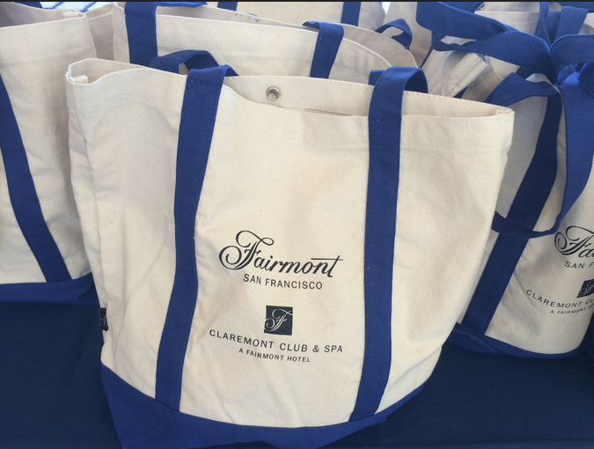
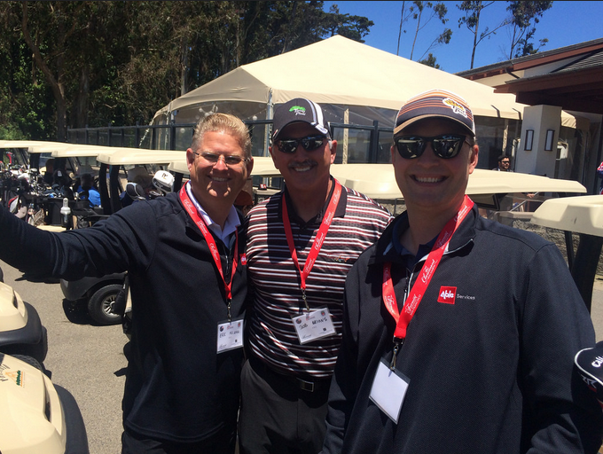
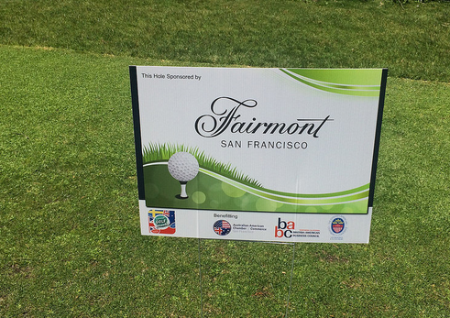
Presenting Sponsor
Benefits $15,000
PRE-EVENT PROMOTION:
Logo in Event Title as Presenting Sponsor and included on Event Branding image
Logo prominently displayed on the Tournament website (Top Position)
Logo prominently displayed on all outbound related promotional email campaigns (Top Position).
Logo on Tournament Lanyards
6 Shout Outs on Social Media
ON-COURSE ACTIVATION:
Three Foursomes
Logo as Presenting Sponsor on Player Gift Bag and the opportunity to place company merchandise/materials in Gift Bag
Company Logo on all Hole Flags, 2 drinks carts and all Hole and Tee Signs
Tent & Table
Double-Page Spread Color Ad in Tournament Program
CLUBHOUSE ACTIVATION:
Opportunity to address the Audience during Awards Reception
12 tickets to Awards Dinner
Logo displayed on TV Screens during Registration & Awards Dinner
Logo on Tournament Banner
Company Pop Up Banner – Sponsor provided
Player RSVP by: September 23rd, 2019
Sponsor Commitments by – September 2nd, 2019

Slide 9
Albatross Sponsor Benefits $7,5000
PRE-EVENT PROMOTION:
Logo in Event Title as Albatross Sponsor and included on Event Branding image
Logo prominently displayed on the Tournament website (Below Presenting)
Logo prominently displayed on all outbound related promotional email campaigns (Below Presenting).
Logo on Tournament Lanyards
4 Shout Outs on Social Media
ON-COURSE ACTIVATION:
Two Foursomes
Logo as Presenting Sponsor on Player Gift Bag and the opportunity to place company merchandise/materials in Gift Bag
Company Logo on 2 drinks carts and 2 Hole and Tee Signs
Tent & Table
Full Page Spread Color Ad in Tournament Program
CLUBHOUSE ACTIVATION:
Opportunity to address the Audience during Awards Reception
8 tickets to Awards Dinner
Logo displayed on TV Screens during Registration & Awards Dinner
Logo on Tournament Banner
Company Pop Up Banner – Sponsor provided
Player RSVP by: September 23rd, 2019
Sponsor Commitments by – September 2nd, 2019

Slide 10
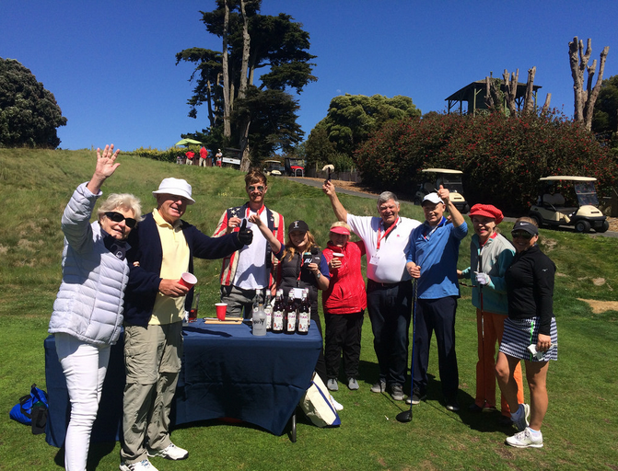
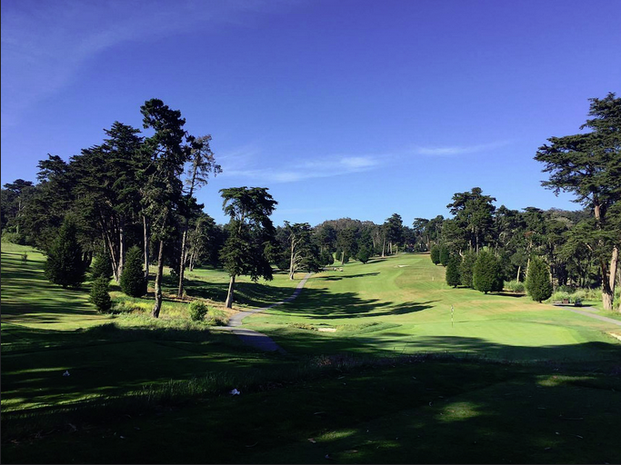
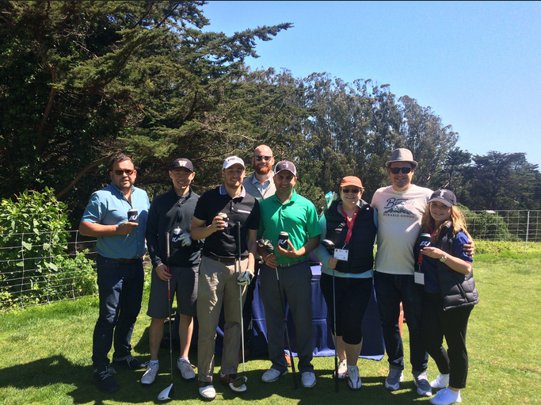
Eagle Sponsor Benefits
$2,500
PRE-EVENT PROMOTION:
Logo displayed on the Tournament website (Below Albatross) and included on Event Branding image
Logo displayed on all outbound related promotional email campaigns (Below Albatross)
3 Shout outs on Social Media
ON-COURSE ACTIVATION:
One Foursome
Opportunity to place company merchandise/materials in Gift Bag
Company Logo on 2 drinks carts and 1 Hole and Tee Sign
Tent & Table
Half Page Color Ad in Tournament Program
CLUBHOUSE ACTIVATION:
4 Tickets to Awards Dinner
Logo displayed on TV Screens during Registration and Awards Dinner
Logo on Tournament Banner
Player RSVP by: September 23rd, 2019
Sponsor Commitments by – September 2nd, 2019

Slide 11
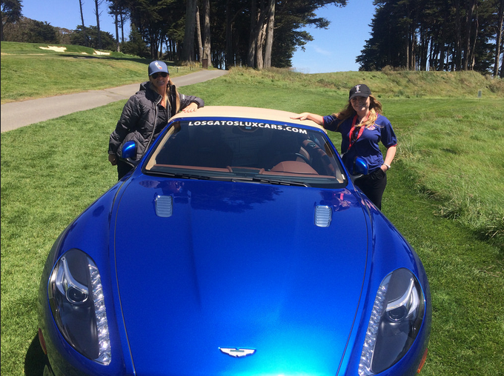
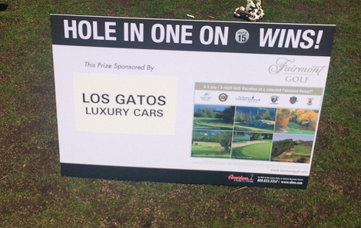
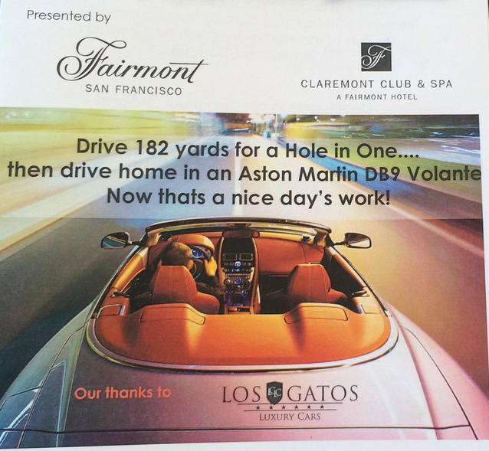
Hole in One Sponsor
$2,500
PRE-EVENT PROMOTION:
Logo displayed on the Tournament website (Below Eagle)
Logo displayed on all outbound related promotional email campaigns (Below Eagle)
3 Shout outs on Social Media
ON-COURSE ACTIVATION:
One Foursome
Opportunity to place company merchandise/materials in Gift Bag
Tee Sign, Tent & Table
Full Page Color Ad in Tournament Program and logo on the Front Cover
CLUBHOUSE ACTIVATION:
4 Tickets to Awards Dinner
Logo displayed on TV Screens during Registration and Awards Dinner
Logo on Tournament Banner
Company Pop Up Banner – Sponsor provided
Player RSVP by: September 23rd, 2019
Sponsor Commitments by – September 2nd, 2019

Slide 12
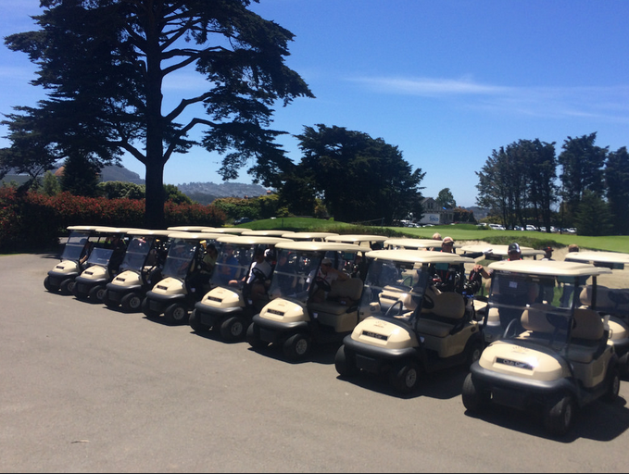
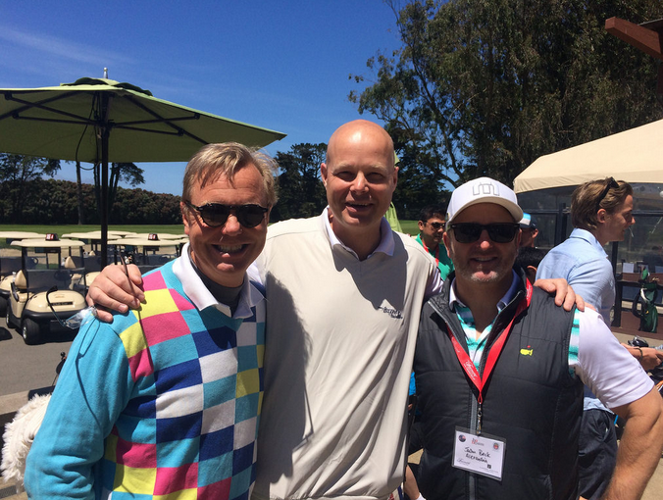
Birdie Sponsor Benefits
$1,500
PRE-EVENT PROMOTION:
Logo displayed on the Tournament website (Below Eagle)
Logo displayed on all outbound related promotional email campaigns (Below Gold).
ON-COURSE ACTIVATION:
Two Player Tickets
Opportunity to place company merchandise/materials in Gift Bag
Hole Sign
Half Page Color Ad in Tournament Program
CLUBHOUSE ACTIVATION:
2 Tickets to Awards Dinner
Logo displayed TV Screens during Registration and Awards Dinner
Logo on Tournament Banner
Player RSVP by: September 23rd, 2019
Sponsor Commitments by – September 2nd, 2019

Slide 13
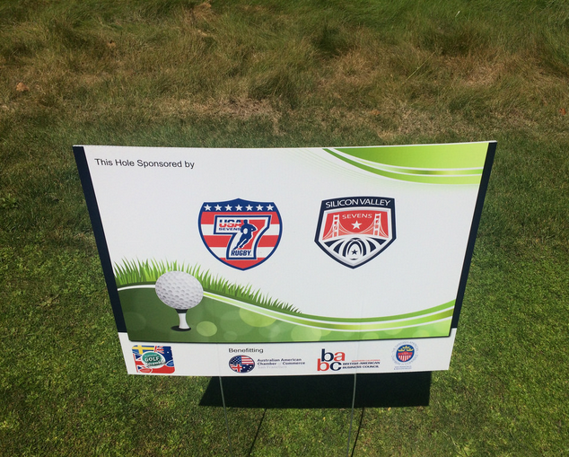
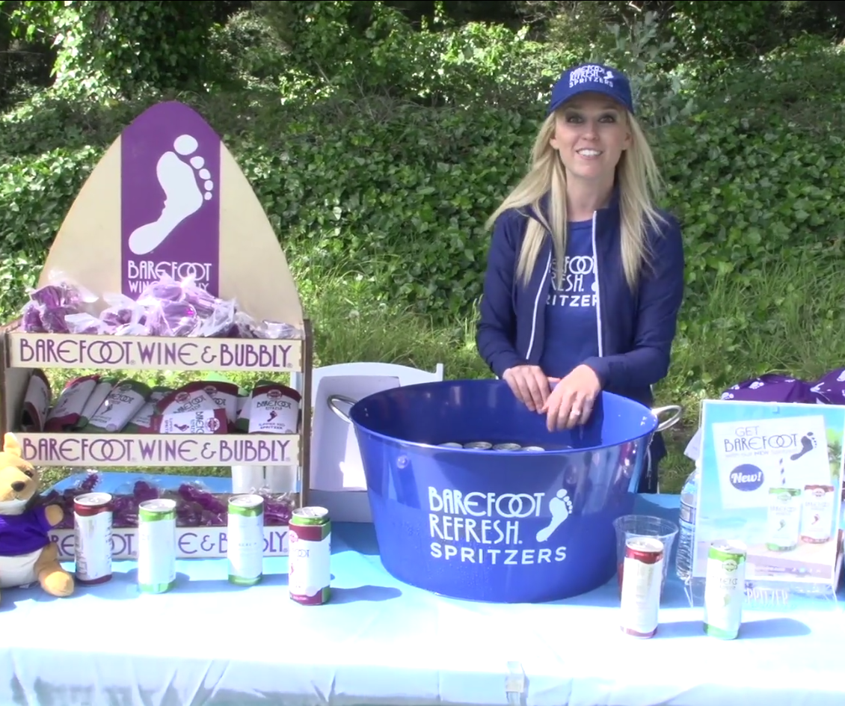
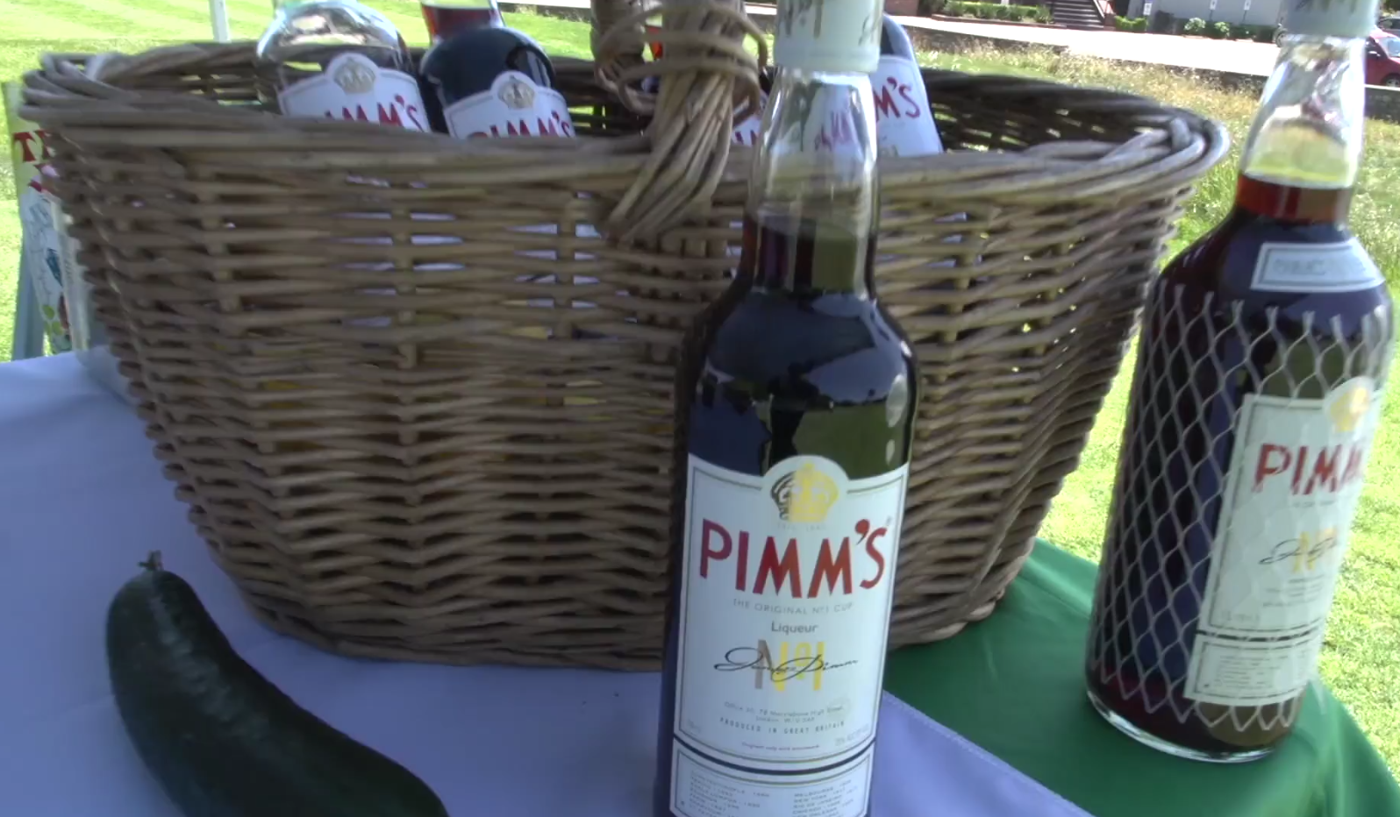
Tee Sponsor Benefits
$1000
Tee Sign / Tent / Table and 2 representatives present at Sponsored Tee
Two Tickets to Awards Dinner
Company Logo appears in Tournament Program
Company logo displayed as Tee sponsor on tournament website
Company logo displayed on Tee Sponsors Slide
Tee sponsors will provide refreshments at sponsored Tee and one of the following:
Promotional giveaway item for all golfers to be placed in Player gift bags ). Minimum of 100 needed)
Prize for Team 1st, 2nd or 3rd Place and opportunity to present the prize to the winner. Minimum of 4 needed.
Player RSVP by: September 23rd, 2019
Sponsor Commitments by – September 2nd, 2019

Slide 14
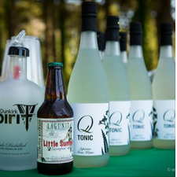
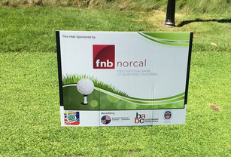
Hole Sponsor Benefits
$500
Hole Sign
Two Tickets to Awards Lunch
Company Logo appears in Tournament Program
Company logo displayed as Hole sponsor on tournament website
Company logo displayed on Hole Sponsor Slide
Hole sponsors will provide one of the following:
Promotional giveaway item for all golfers for gift bag
Prize for contest (e.g. longest drive, closest to the pin, fun contest)
Player RSVP by: September 23rd, 2019
Sponsor Commitments by – September 2nd, 2019

Slide 15
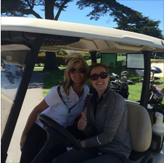
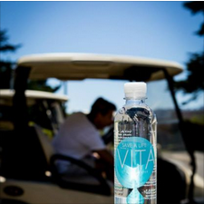
Drink Cart Sponsor
Benefits
$250
Logo on your drinks carts sign
Two Tickets to Awards Dinner
The opportunity to provide company merchandise and/or materials to all players in their bag
Player RSVP by: September 23rd, 2019
Sponsor Commitments by – September 2nd, 2019

Slide 16
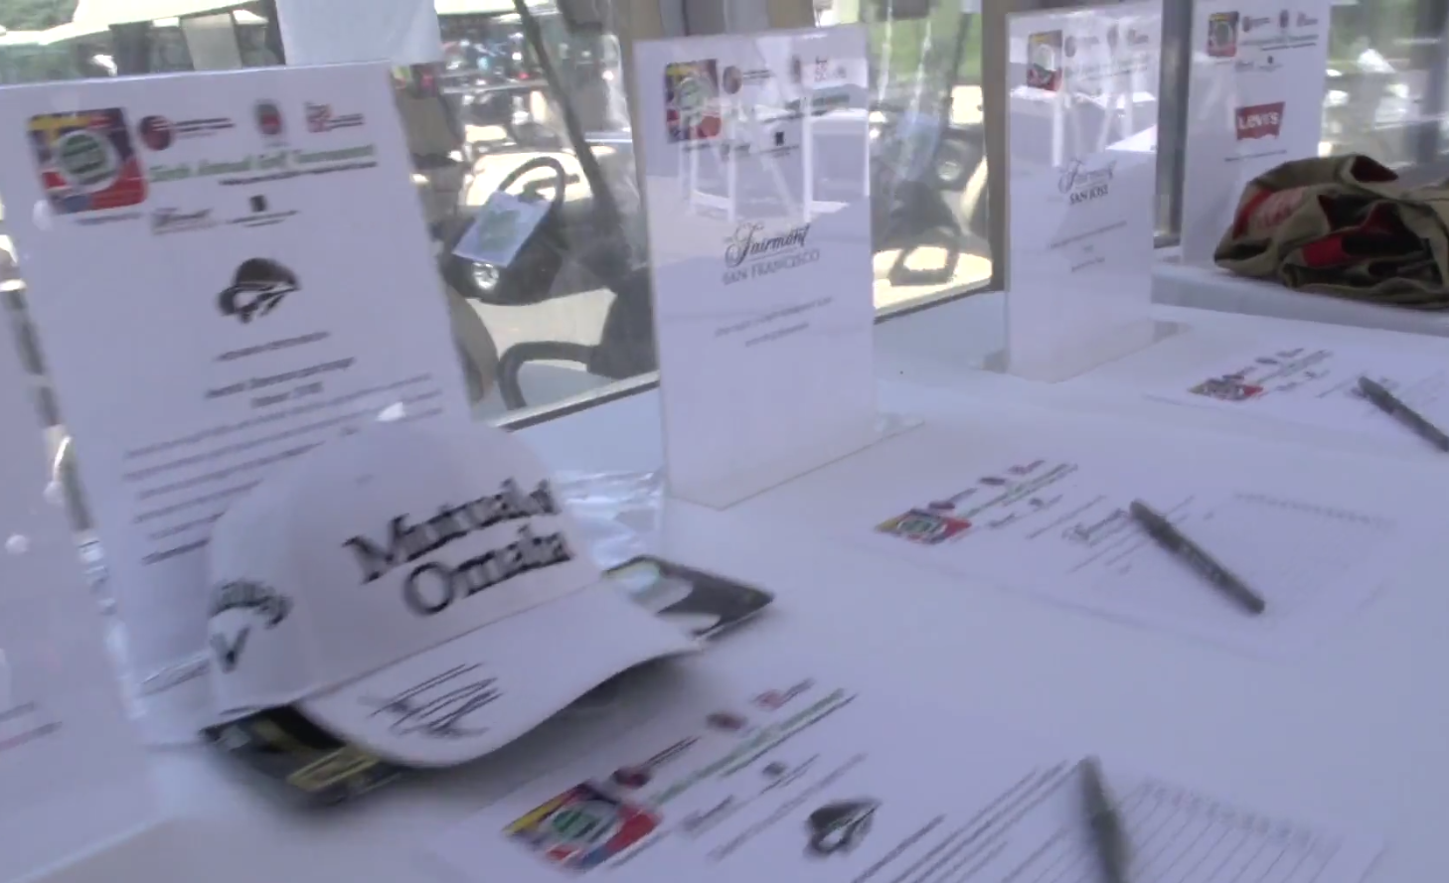
In-Kind Sponsor Benefits
Live Auction Items
Silent Auction Items
Wine Sponsor(s)
Beer Sponsor(s)
Liquor Sponsor(s)
Gifts for Player Gift Bags
Sponsor benefits can be tailored based on the value of the donations
Note: Benefits exclude player participation
Player RSVP by: September 23rd, 2019
Sponsor Commitments by – September 2nd, 2019

Slide 17
Contact Information
Dawn Lillington
Australian American Chamber of Commerce
dawn@sfaussies.com
www.sfaussies.com
Jo Healey
British American Business Council
jhealey@babcsf.org
www.babcsf.org
Player RSVP by: September 23rd, 2019
Sponsor Commitments by – September 2nd, 2019

